Slide 1
Multi-resolution apps for Windows Phone 8
ALEKSANDR KRAKOVETSKYI
CEO, DevRain Solutions
Microsoft RD/MVP, PhD., @msugvnua
http://wp7rocks.com

Slide 2
Supported resolutions

Slide 3
Supported resolutions
Resolution | Resolution | Aspect ratio | Delta from Windows Phone OS 7.1 | Scaled resolution
WVGA | 480 × 800 | 15:9 | None. This is the only supported resolution for Windows Phone OS 7.1. | 480 × 800
WXGA | 768 × 1280 | 15:9 | 1.6x scale | 480 × 800
720p | 720 × 1280 | 16:9 | 1.5x scale, 80 pixels taller (53 pixels, after scaling) | 480 × 853

Slide 4
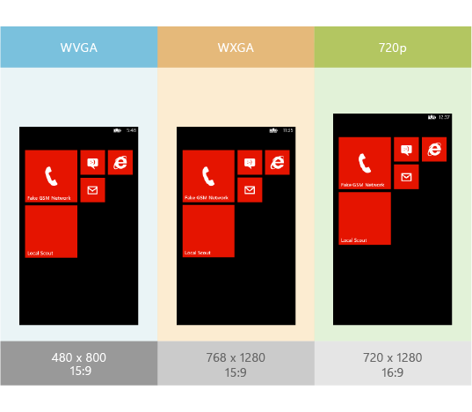
Supported resolutions
do not hard-code the height and width or the margins of the controls;
use * and the Auto value to set the height and width of its rows and columns.

Slide 5
Resolution-dependent backgrounds and assets

Slide 6
Detecting actual resolution
public enum Resolutions { WVGA, WXGA, HD720p };
public static class ResolutionHelper
{
private static bool IsWvga { get { return App.Current.Host.Content.ScaleFactor == 100; } }
private static bool IsWxga { get { return App.Current.Host.Content.ScaleFactor == 160; } }
private static bool Is720p { get { return App.Current.Host.Content.ScaleFactor == 150; } }
public static Resolutions CurrentResolution {
get
{
if (IsWvga) return Resolutions.WVGA;
else if (IsWxga) return Resolutions.WXGA;
else if (Is720p) return Resolutions.HD720p;
else throw new InvalidOperationException("Unknown resolution");
}
}
}

Slide 7
MultiResImageChooser.cs
using System.Windows.Media.Imaging;
public class MultiResImageChooserUri {
public Uri BestResolutionImage {
get {
switch (ResolutionHelper.CurrentResolution) {
case Resolutions.HD720p:
return new Uri("Assets/MyImage.screen-720p.jpg", UriKind.Relative);
case Resolutions.WXGA:
return new Uri("Assets/MyImage.screen-wxga.jpg", UriKind.Relative);
case Resolutions.WVGA:
return new Uri("Assets/MyImage.screen-wvga.jpg", UriKind.Relative);
default:
throw new InvalidOperationException("Unknown resolution type");
}
}
}
}

Slide 8
Splash screens

Slide 9
Splash screens
Add images with the following file names:
SplashScreenImage.Screen-WVGA.jpg
SplashScreenImage.Screen-WXGA.jpg
SplashScreenImage.Screen-720p.jpg
All splash screen images must be in the root folder of your app project.

Slide 10
Tile and app icons

Slide 11
Tile and app icons
For Tile and app icons, you have to include images only for WXGA resolution. The phone automatically scales the images to the correct size for WVGA and 720p screens.

Slide 12
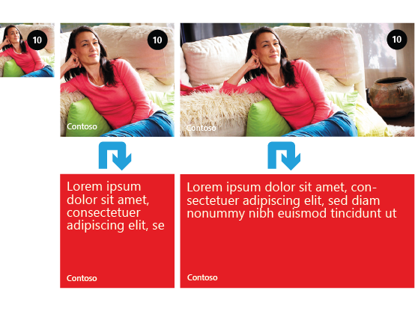
Flip Template

Slide 13
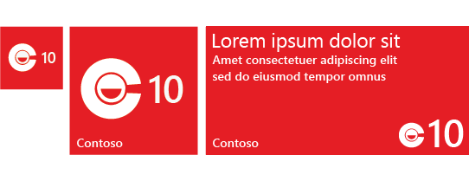
Iconic Template

Slide 14
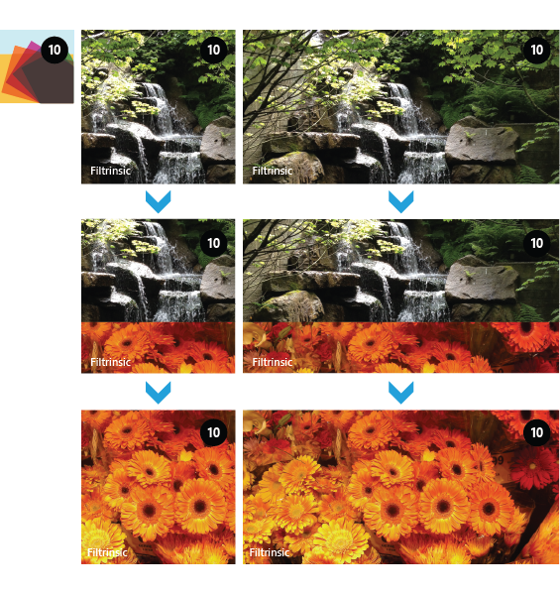
Cycle Template

Slide 15
WXGA resolution Tile sizes
 | Flip and Cycle | Iconic
Small | 159 × 159 pixels | 110 × 110 pixels
Medium | 336 × 336 pixels | 202 × 202 pixels
Wide | 691 × 336 pixels | N/A

Slide 16
Resources
Windows Phone 7 Rocks!
http://wp7rocks.com

Slide 17
Q&A
@msugvnua
Alex.Krakovetskiy@devrain.com

